Slide 1
Learning intentions and success criteria
I am learning…
I can…
About data representation
How to convert binary numbers
Describe how different types of data are represented and stored in a computer
Convert between binary and decimal numbers

Slide 2

Data Representation
N5 – Computer Systems

Slide 3
Types of Data
Computer can store and represent lots of different kinds of data. You will learn how computers store the following types:
Numbers
Binary
Floating point representation
Text
ASCII code
Graphics
Vector graphics
Bitmapped graphics

Slide 4
How Humans Count (Decimal)
We represent numbers in base-10:
Each digit is a power of 10 (units, tens, hundreds, etc.)
Thousands (10³) | Hundreds (10²) | Tens (10¹) | Units (10⁰)
3 | 2 | 8 | 6
10³ means 10 x 10 x 10
Calculating this number:
3 x 10³ = 3000
2 x 10² = 200
8 x 10¹ = 80
6 x 10⁰ = 6
3000 + 200 + 80 + 6
= 3286

Slide 5
How computers count
Computers count in base-2 instead of base-10:
0s and 1s
Each digit is powers of 2 (twos, fours, eights, sixteens, etc.)
128 (2⁷) | 64 (2⁶) | 32 (2⁵) | 16 (2⁴) | 8 (2³) | 4 (2²) | 2 (2¹) | 1 (2⁰)
1 | 0 | 1 | 0 | 0 | 1 | 0 | 1
2⁴ means 2 x 2 x 2 x 2
To convert a binary number to denary:
Add up all the columns with a 1 underneath
Answer = 128
+ 32
+ 4
+ 1
10100101 = 165
= 165
5

Slide 6
From Decimal to Binary
But how do we go from a decimal number to a binary number?
e.g. Convert 99 in binary
First, set up your columns and a remainder box:
Remainder:
99
128 | 64 | 32 | 16 | 8 | 4 | 2 | 1
6

Slide 7
From Decimal to Binary
First, find the largest number which is smaller than the remainder:
E.g. 64 is the largest number smaller than 99
Write a 1 underneath and subtract 64 from the remainder
Remainder:
99
99 – 64 = 35
128 | 64 | 32 | 16 | 8 | 4 | 2 | 1
1
7

Slide 8
From Decimal to Binary
Then find the largest number which is smaller than the new remainder:
The new remainder is 35
The largest column is 32 – fill in a 1 and subtract from the remainder
Remainder:
35
35 – 32 = 3
128 | 64 | 32 | 16 | 8 | 4 | 2 | 1
1
1
8

Slide 9
From Decimal to Binary
Keep going until your remainder is zero:
Then fill in the empty columns with zero
You will have your final binary number
Remainder:
3
3 – 2 – 1 = 0
128 | 64 | 32 | 16 | 8 | 4 | 2 | 1
1
1
1
1
9

Slide 10
From Decimal to Binary
Result:
99 in decimal is 01100011 in binary
Remainder:
0
128 | 64 | 32 | 16 | 8 | 4 | 2 | 1
0
1
1
0
0
0
1
1
10

Slide 11
Real Numbers
We don’t just deal with whole numbers (Integers):
Real numbers have decimal points
How are they represented inside a computer?
A computer cannot store numbers like this using the normal binary method:
They are stored using a method called Floating Point Representation
3.1415 18.38 0.0002569
11

Slide 12

Floating Point Representation
Floating point representation involves using two parts to store a number, the mantissa and the exponent:
The mantissa is used to store the accuracy/precision of a number.
The exponent is used to store the range of a number.
By using this, you can represent any positive real number.
12

Slide 13
Representing Text
ASCII stands for American Standard Code for Information Interchange:
ASCII code allows computers to understand how to represent text
In ASCII, each character is represented by a binary value
The letter ‘A’ is represented by 65 = 0100 0001 in binary
Extended ASCII uses 8-bits to represent characters:
i.e. each character has its own 8-digit binary number
There are 256 characters in extended ASCII’s character set
13

Slide 14

Representing Graphics
Graphics are things like images and diagrams you might store on your computer. There are two ways to represent graphics:
Bitmapped graphics
Vector graphics
14

Slide 15
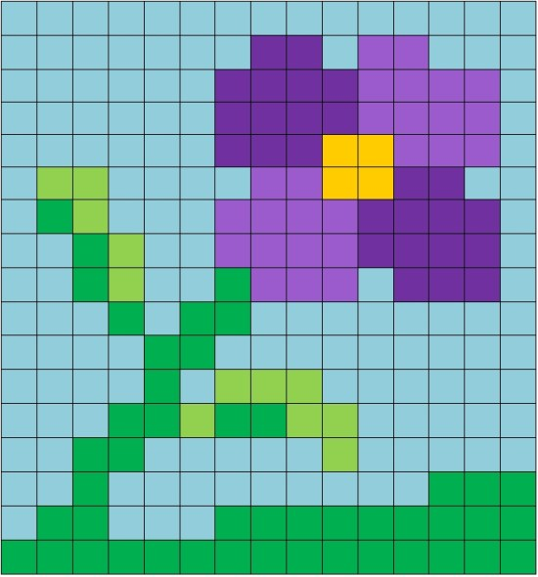
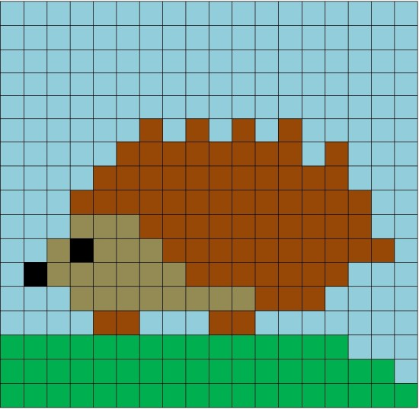
Bitmapped Graphics
A bitmap graphic is one that stores an image using a grid of pixels. Each pixel will be stored as a binary number:
The number of pixels in an image is referred to as the Resolution
They can be very detailed in quality so are good for storing photographs and allow detailed editing
However, they can have large file sizes as each pixel's data must be stored.
15

Slide 16


Vector Graphics
Vector graphics are stored in a different way – no pixels used:
Vectors images are stored with objects and attributes using a mathematical formula
They can be layered
They can be resized without loss of quality
They are resolution independent
They tend to have smaller file sizes than Bitmaps
16

Slide 17
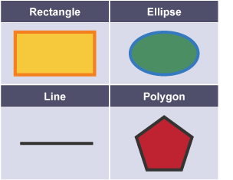
Vector Graphics - Objects
Vector graphics are made up of objects – these can include:
Rectangle
Ellipse
Line
Polygon
Using a combination of these objects, a complex graphic can be produced.
17

Slide 18
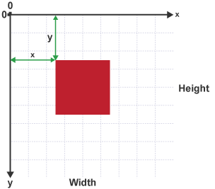
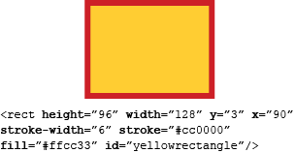
Vector Graphics - Attributes
The main attributes used to create an object as part of a vector graphic are:
co-ordinates
fill colour
line colour
Every object in a vector graphic is given a position (co-ordinate):
The X value determines how far to the right the object should be placed
The Y value determines how far from the top the object should be placed.
18

Slide 19
Vector Graphics - Attributes
Fill colour
The fill colour attribute is used to define the colour inside an object.
Line colour
Often referred to as stroke colour, the line colour attribute is used to define the colour of the outer line of an object.
19

Slide 20
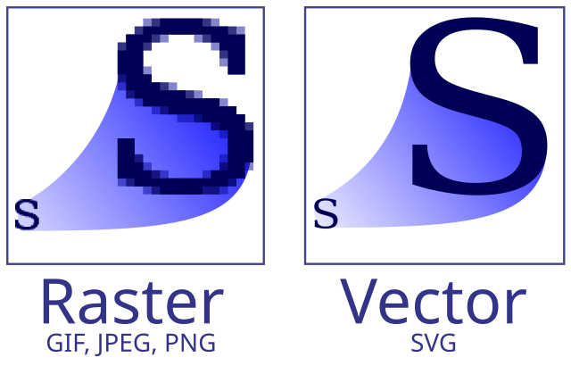
Common File Formats
Bitmapped Images
JPG
PNG
GIF
WEBP
Vector Images
SVG
PDF
EPS
AI
20

